Slide 1

CSCI 1102 Computer Science 2
Meeting 3: Thursday 2/4/2021
More on Java

Slide 2
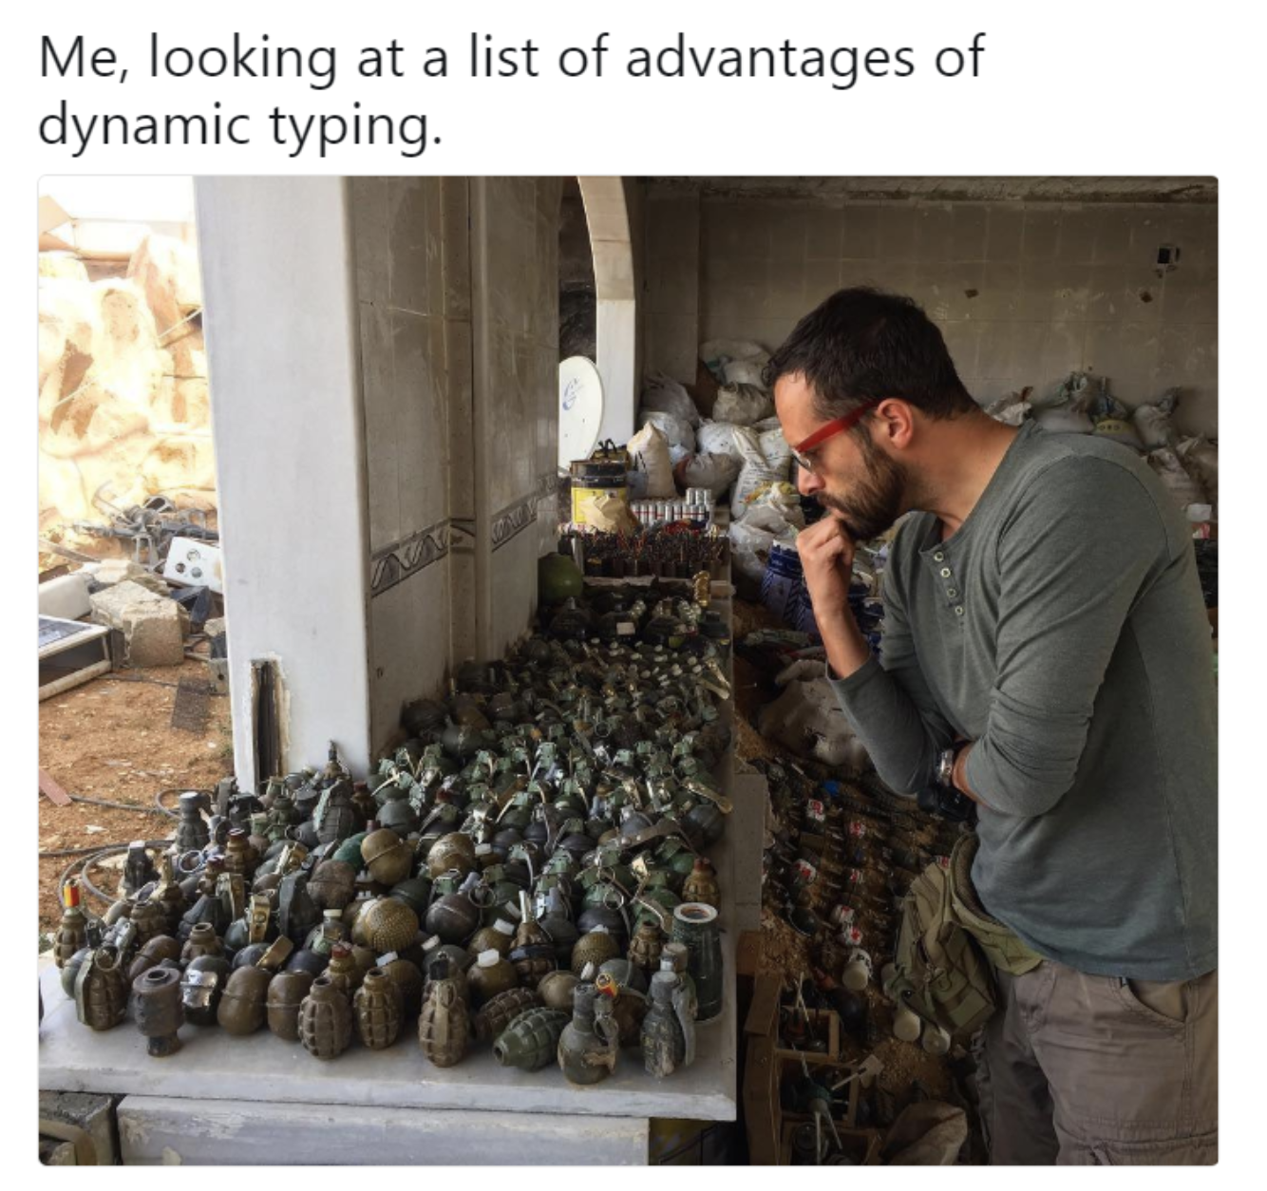
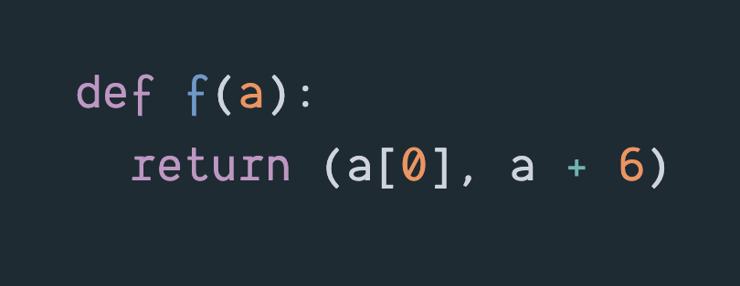
Python & Dynamic Typing

Slide 3
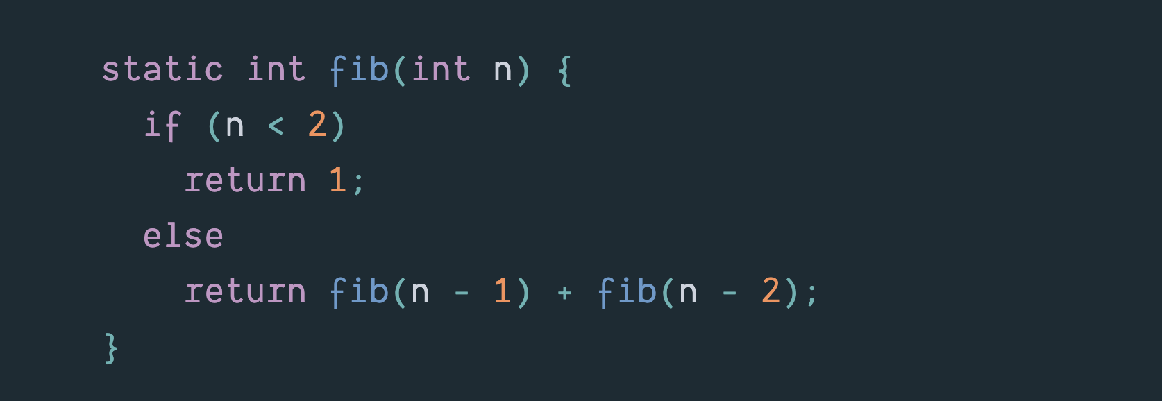
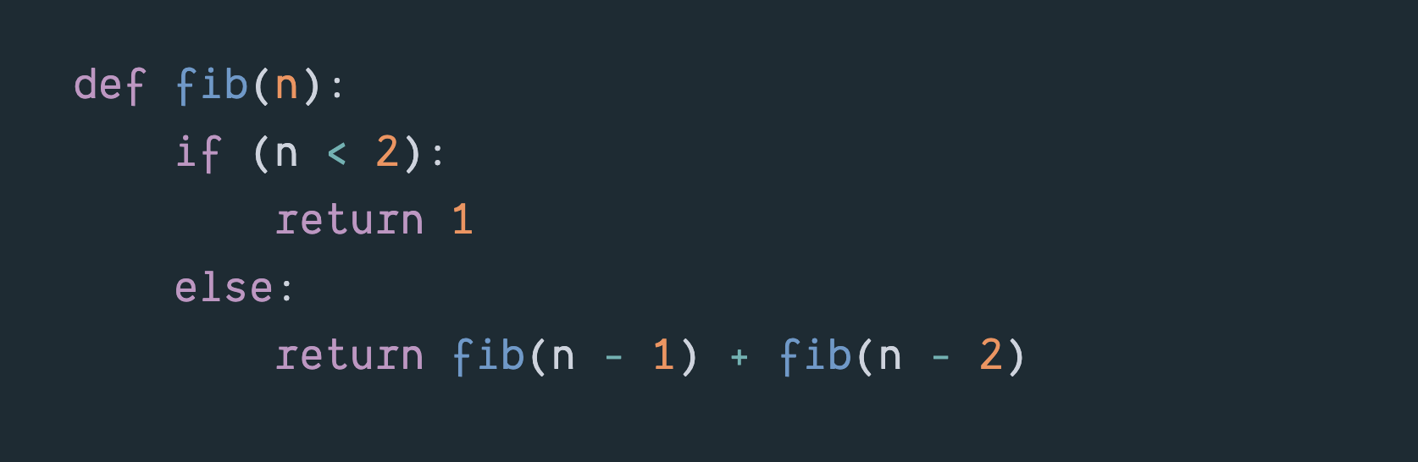
Two wildly inefficient Fibonacci functions.

Slide 4
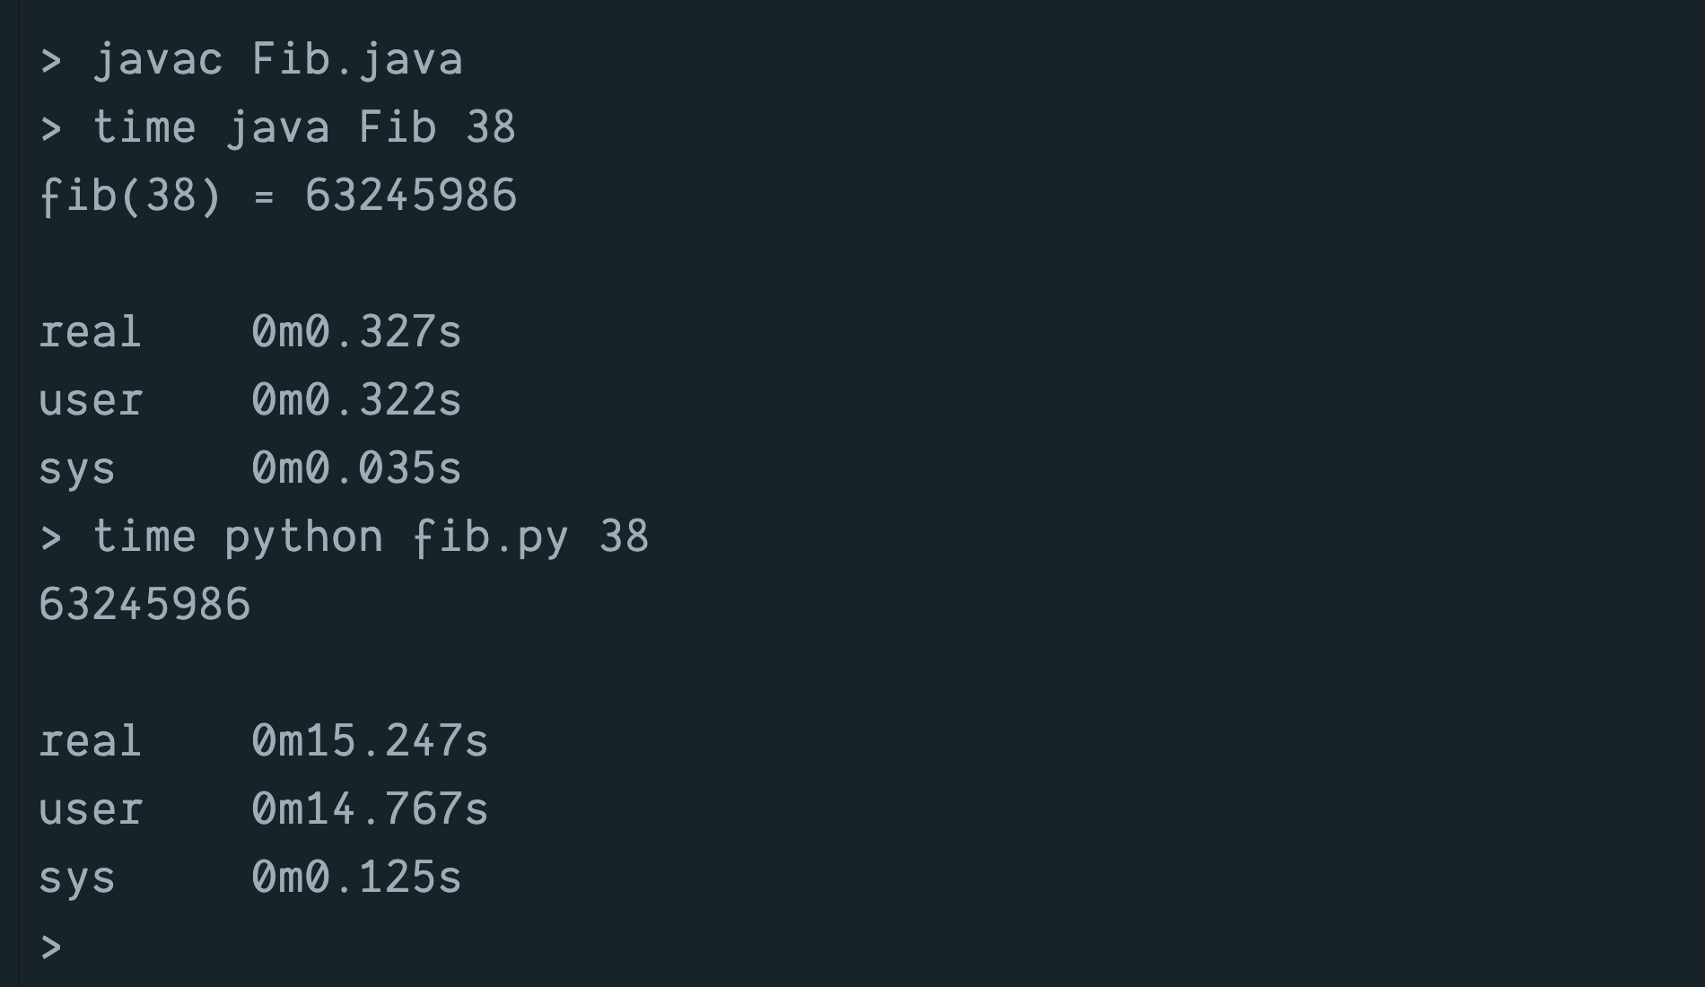
Run-times on VMs for fib(38)
The Python time includes time for translation.

Slide 5
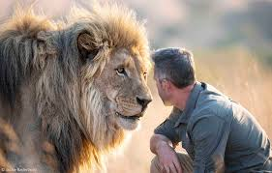
But Java is Huge & Wildly Complicated

Slide 6
Today
Message-Passing Style
Frequency Table Example
Abstract Data Types

Slide 7
Example: Who is taking CS2?

Slide 8
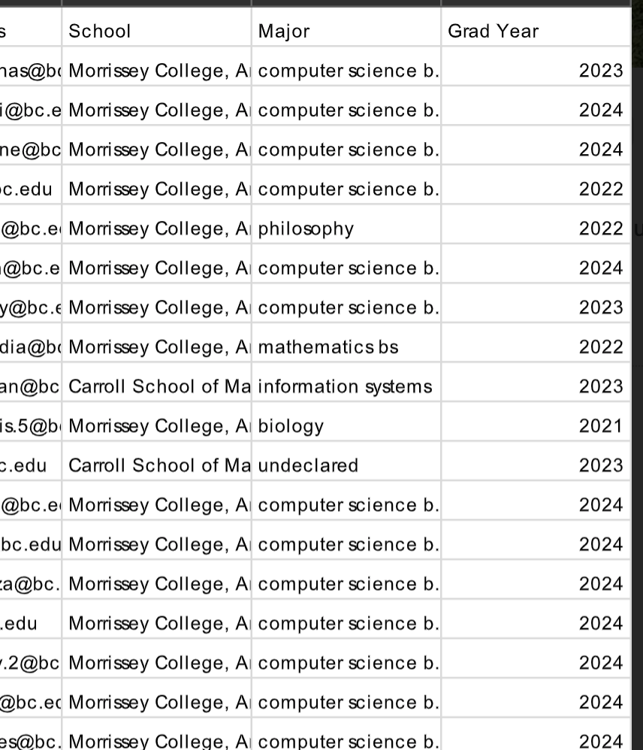
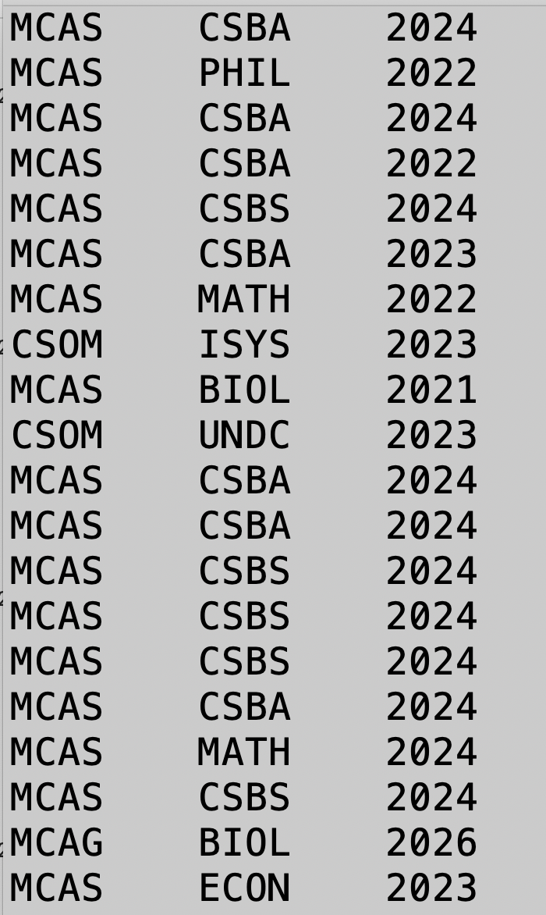

Slide 9
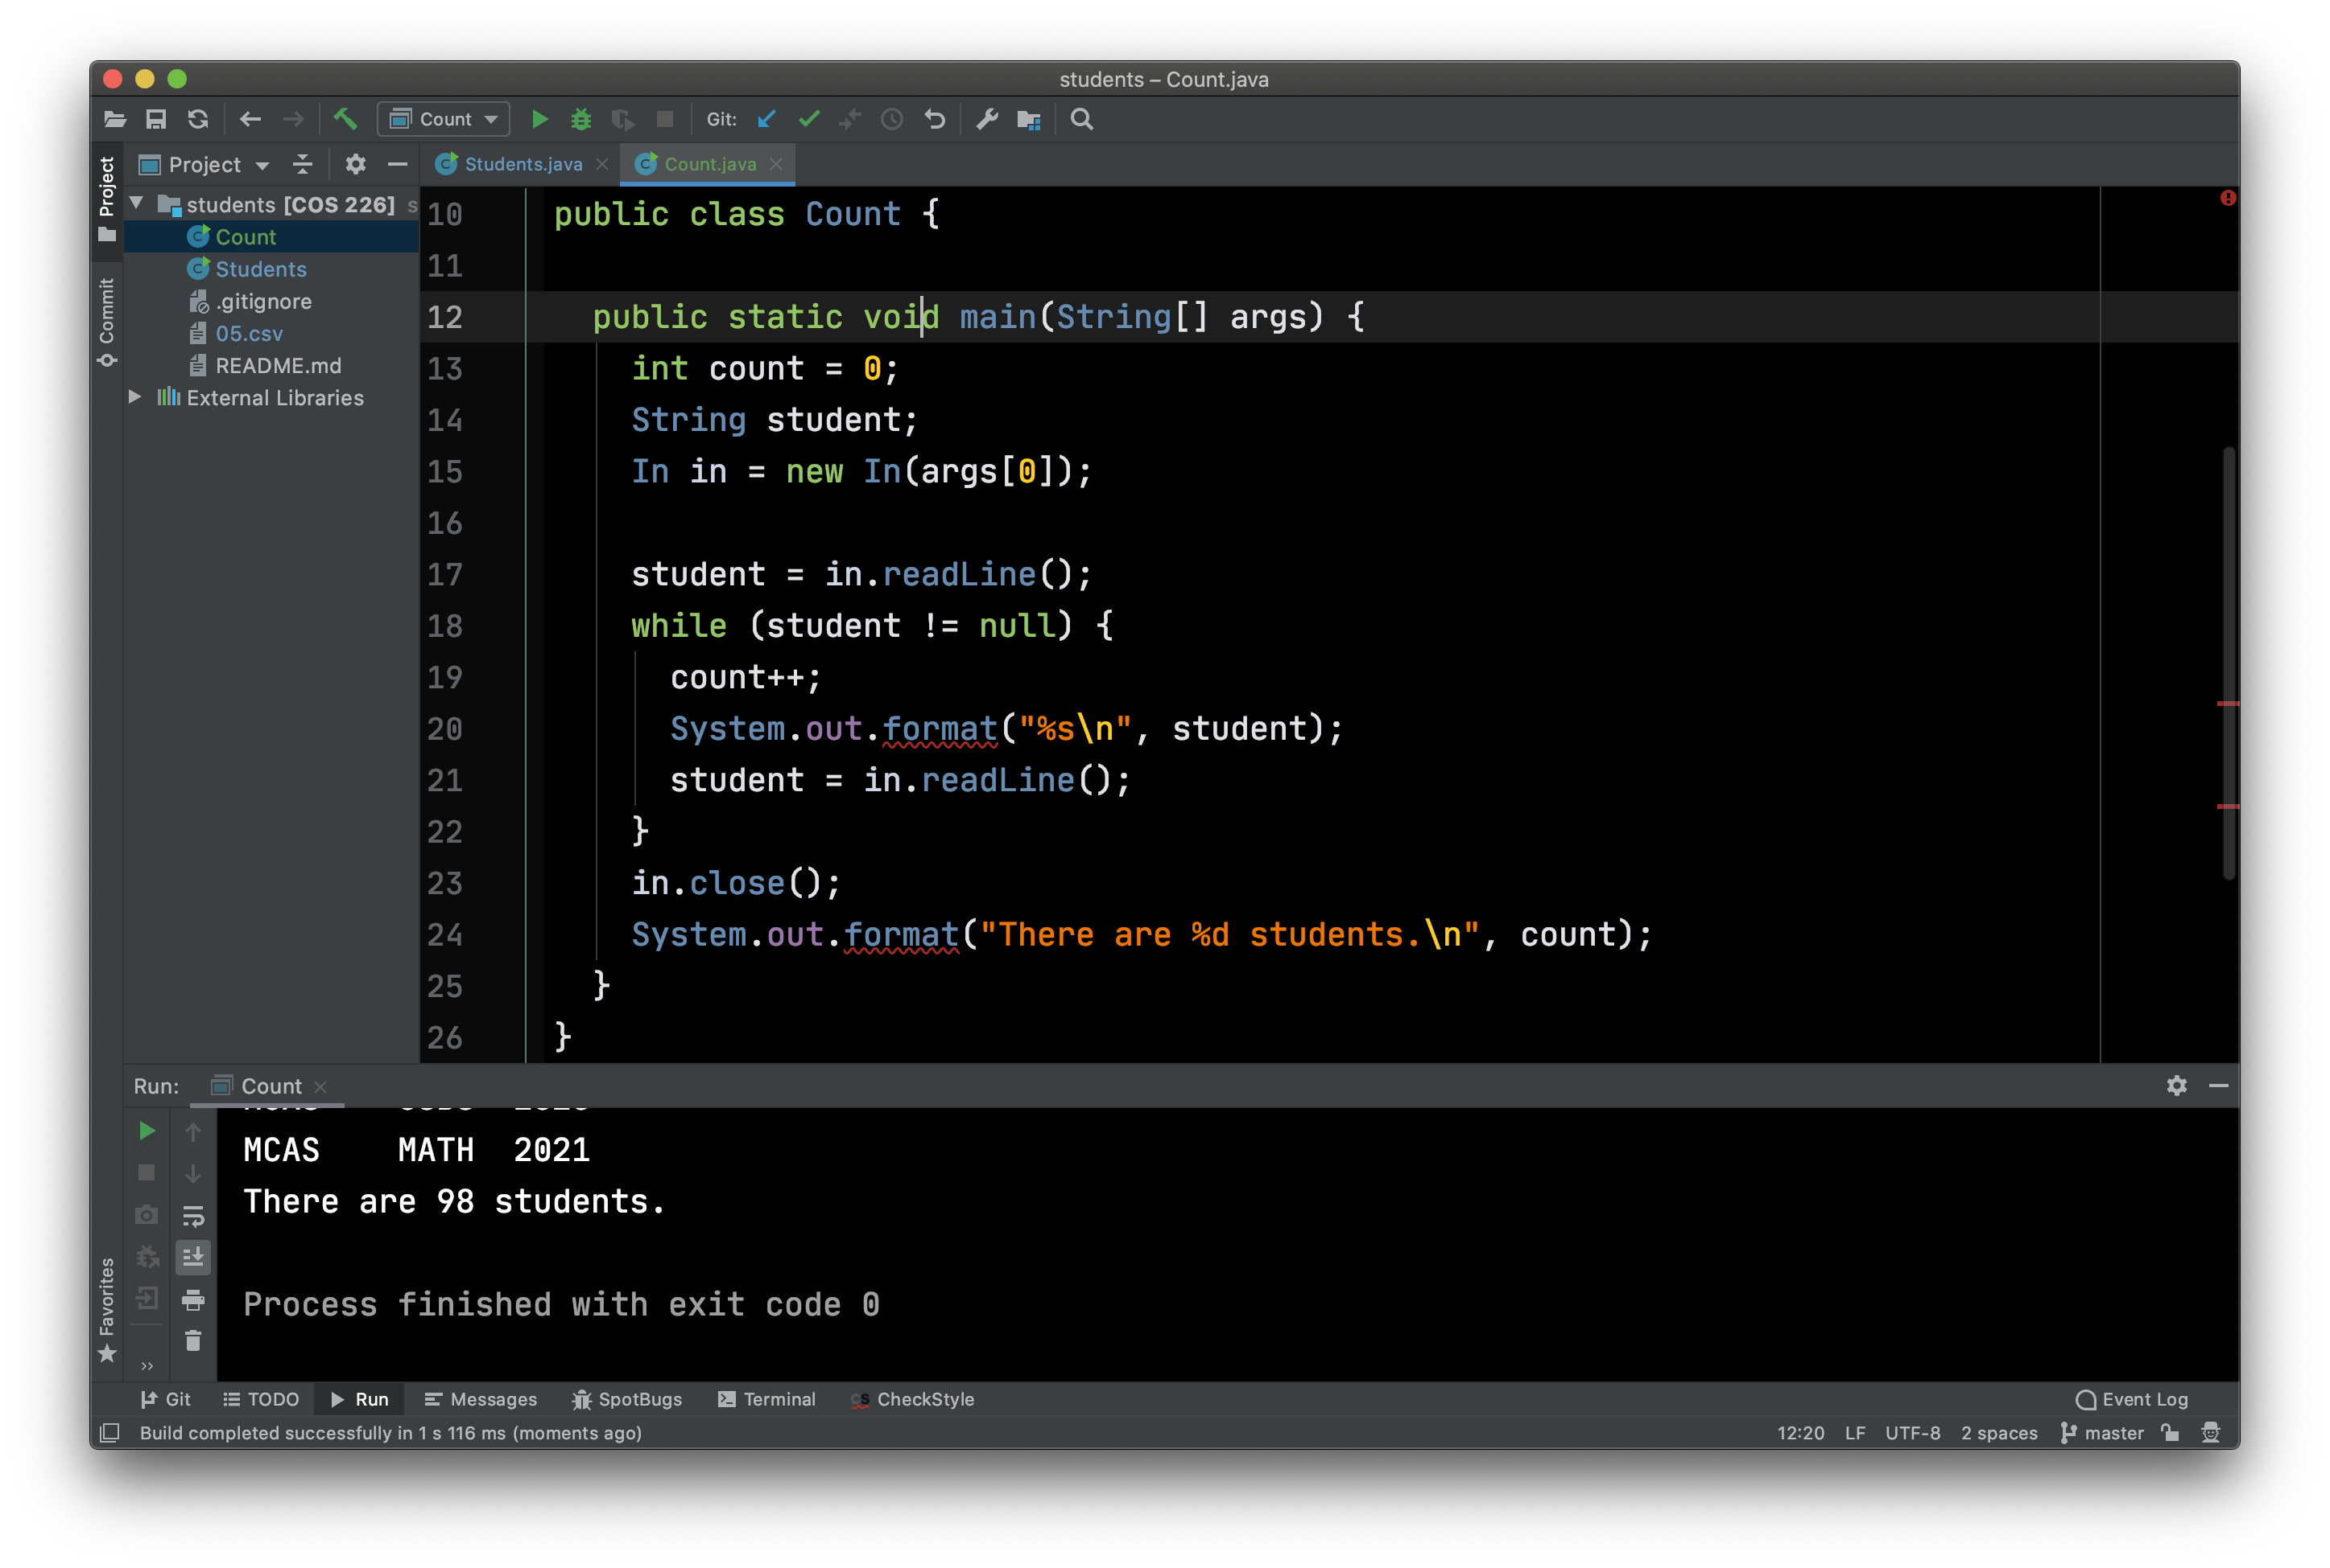
Count Enrolled Students

Slide 10
Message Passing Style
In the Count example, in is an input channel and readLine is a function.
In standard mathematical style, we read a line from the input channel using standard function call notation: readLine(in)
static functions are called using the standard notation.

Slide 11
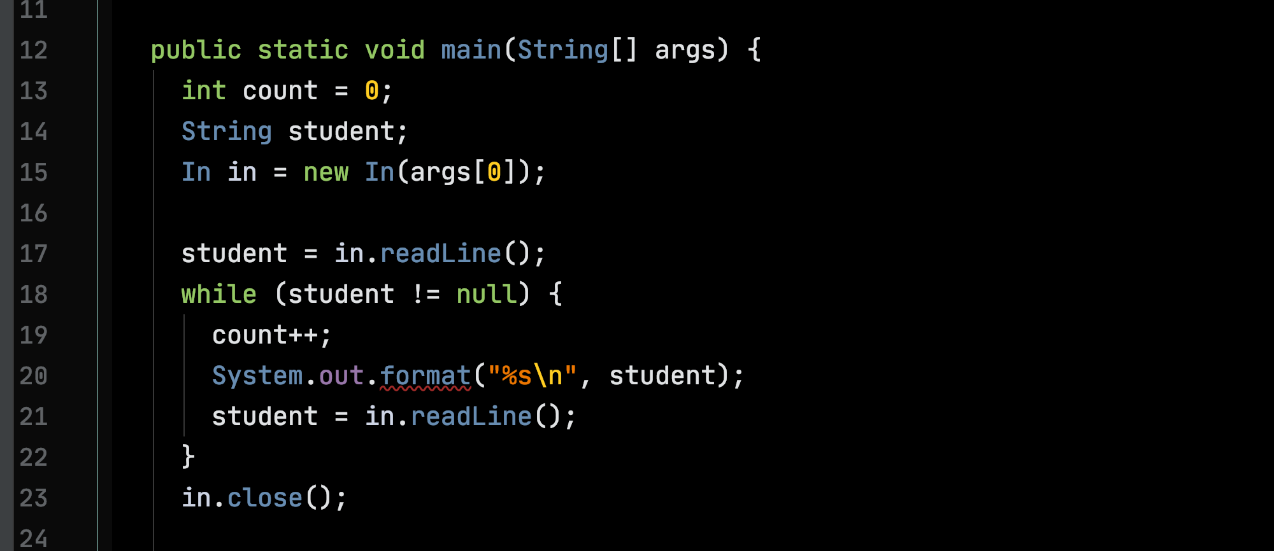
Message Passing Style
Non-static (or “dynamic”) functions are called in message-passing style: in.readLine()

Slide 12
Message Passing Style
The input channel in is understood to be a structure (aka, an “object”) containing functions

Slide 13
Message Passing Style
in.readLine is sometimes interpreted as “send the readLine message to channel in”

Slide 14
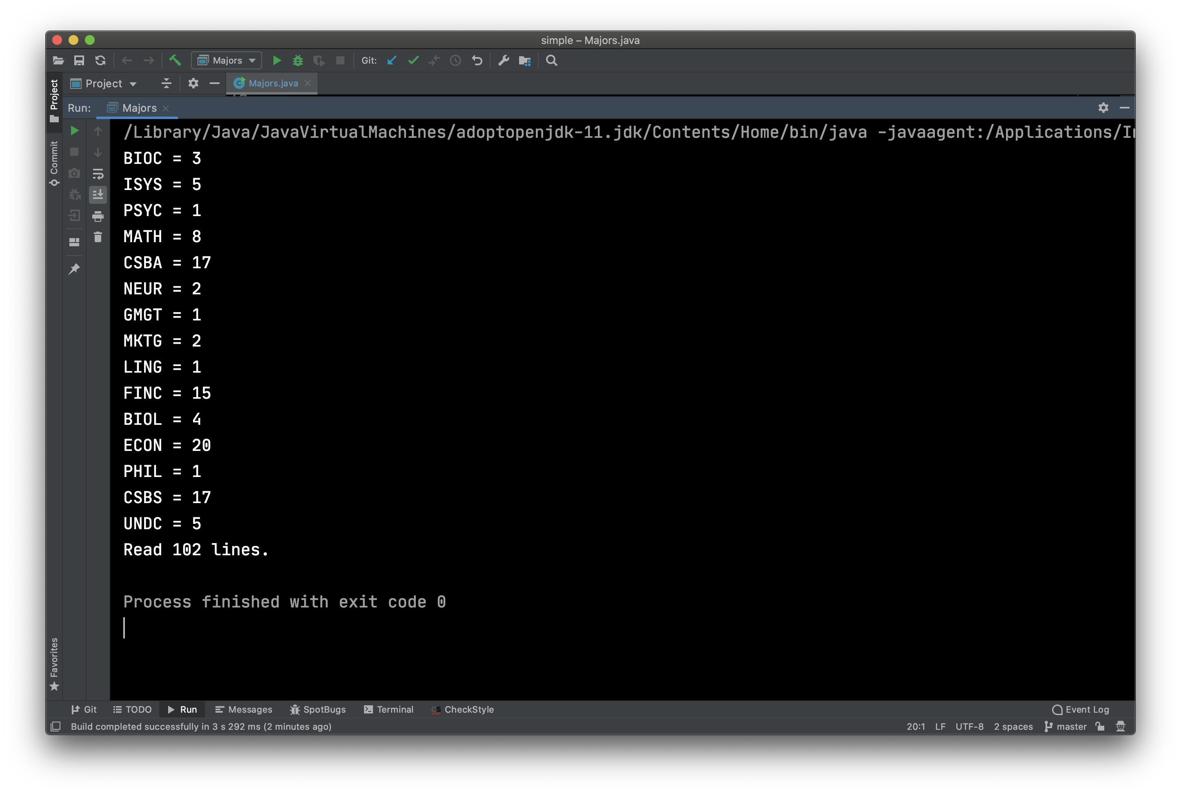
Compute a Frequency Table of Majors

Slide 15
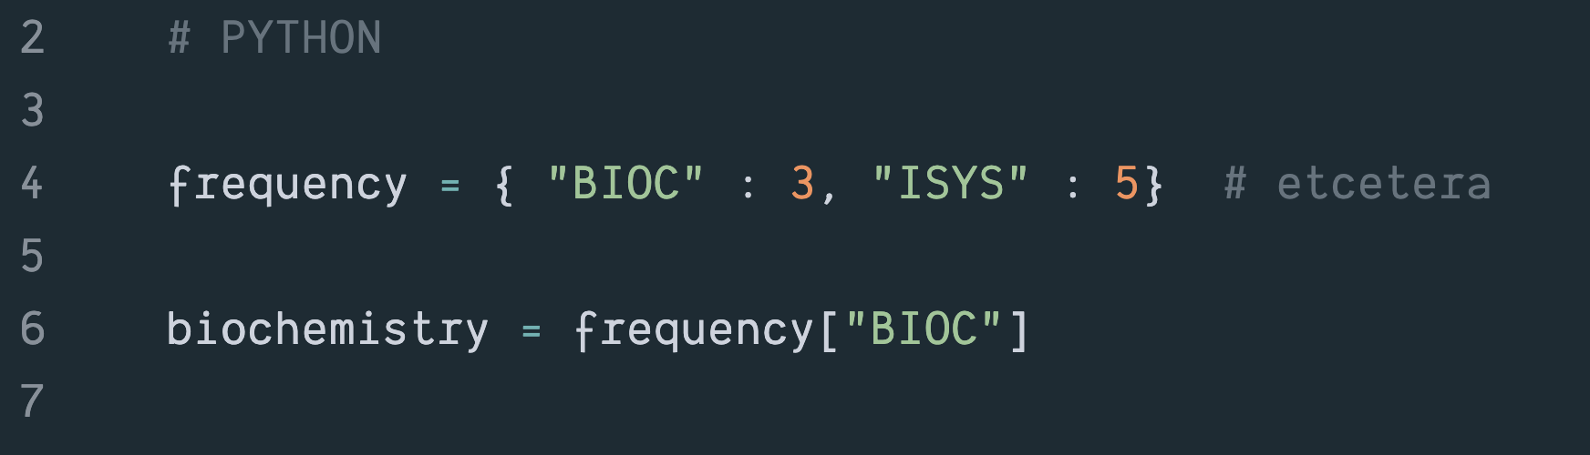
Map/Dictionary -- Python

Slide 16
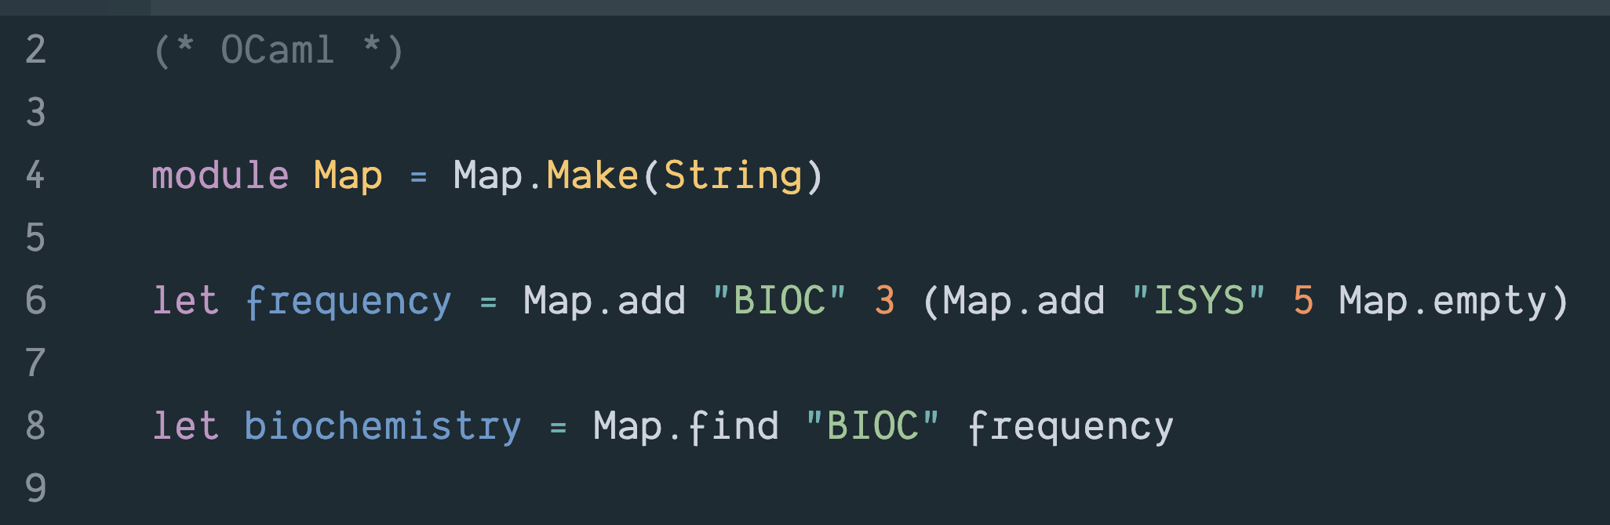
Map/Dictionary -- OCaml

Slide 17
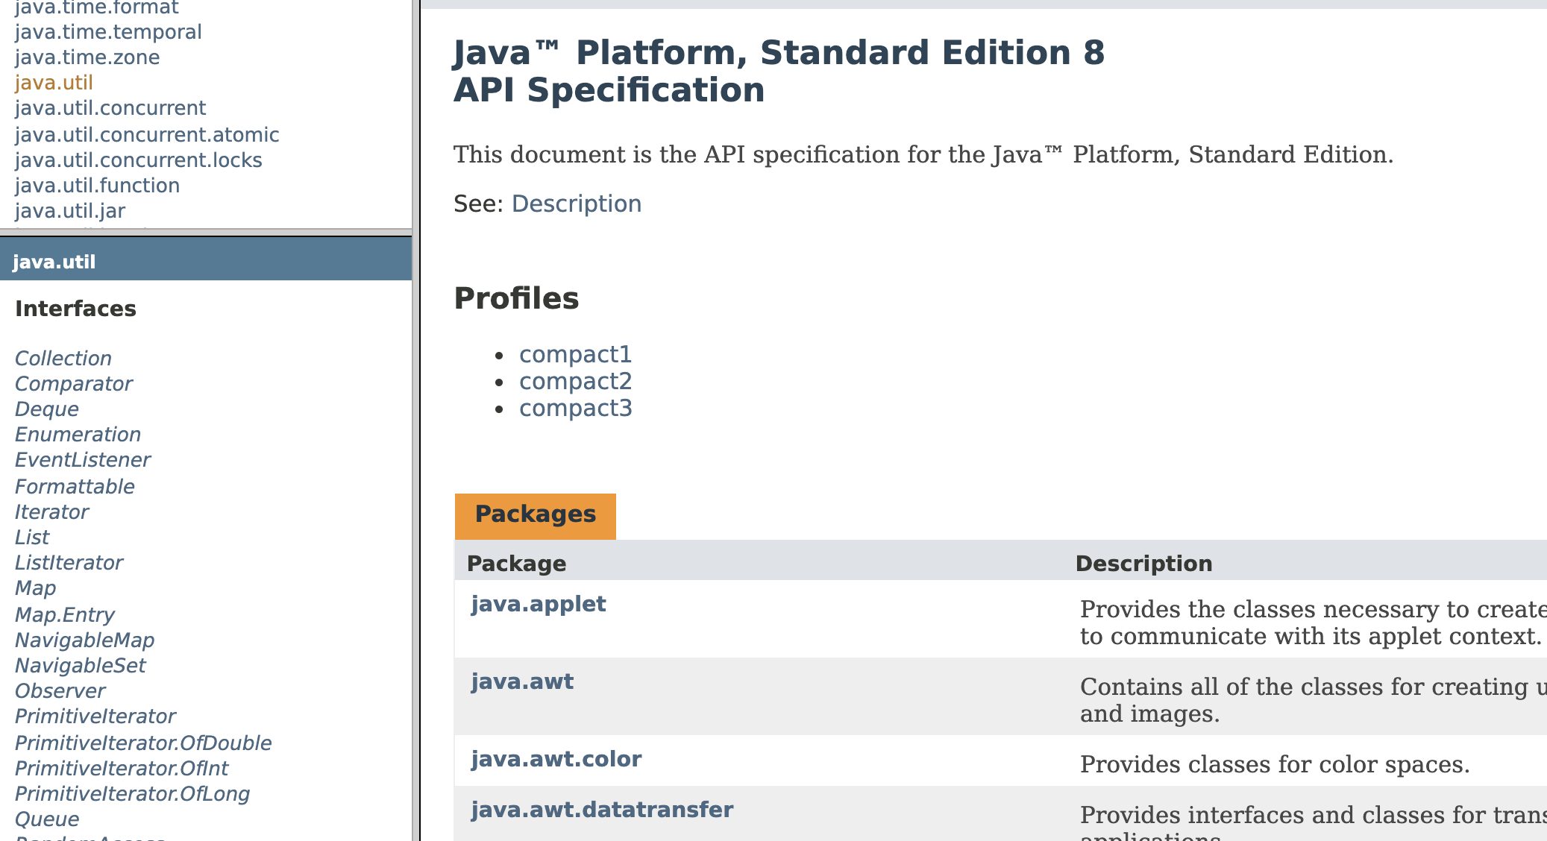
Map/Dictionary -- Java

Slide 18
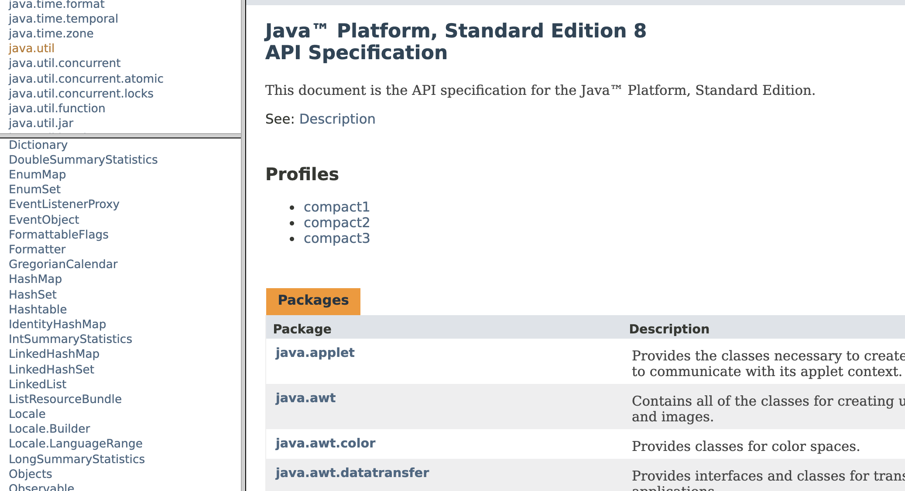
Map/Dictionary -- Java

Slide 19
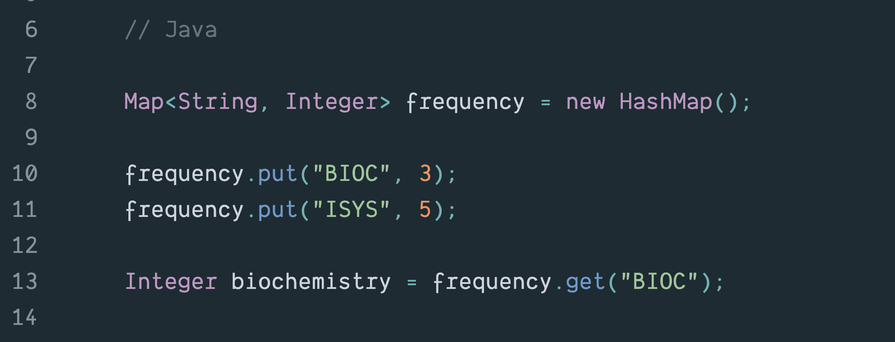
Map/Dictionary -- Java

Slide 20
Map/Dictionary -- Java
An interface
A class

Slide 21
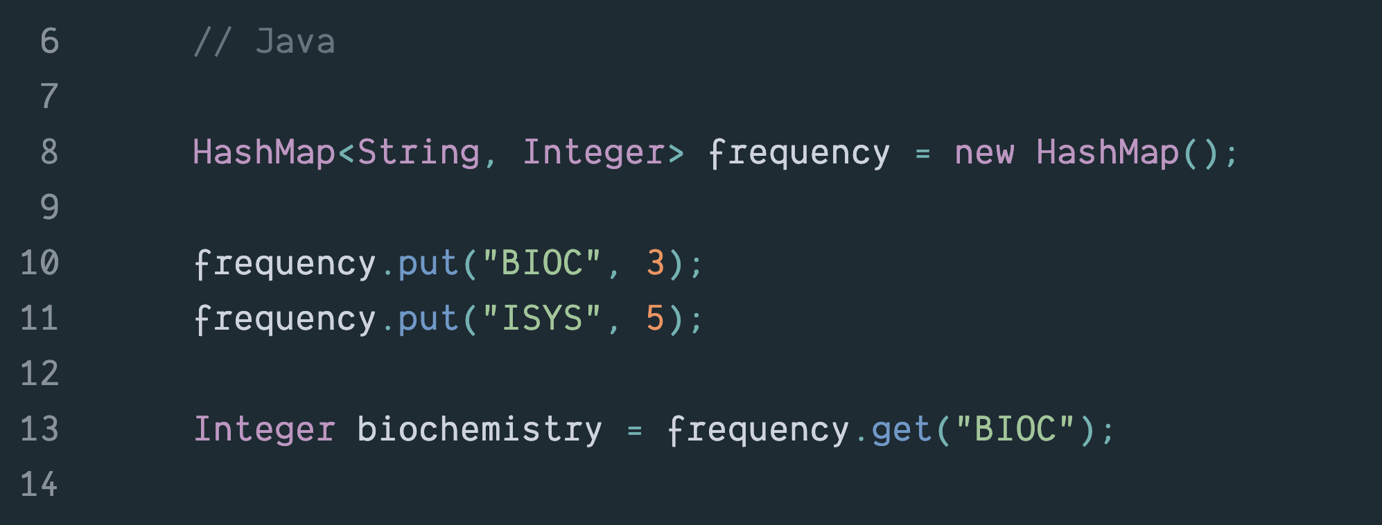
NB: This Works but Avoid if Possible
A class
A class

Slide 22
Map/Dictionary -- Java
Key
Value

Slide 23
Digression 1: – Base Types & Wrapper Classes
A reference type
Values of base type int

Slide 24
Base Types & Wrapper Classes
Base Type | Wrapper Class/Type
int (32-bit integers) | Integer
long (64-bit integers) | Long
short (16-bit integers) | Short
byte (8-bit integers) | Byte
float (32-bit floats) | Float
double (64-bit floats) | Double
char | Character
boolean | Boolean

Slide 25
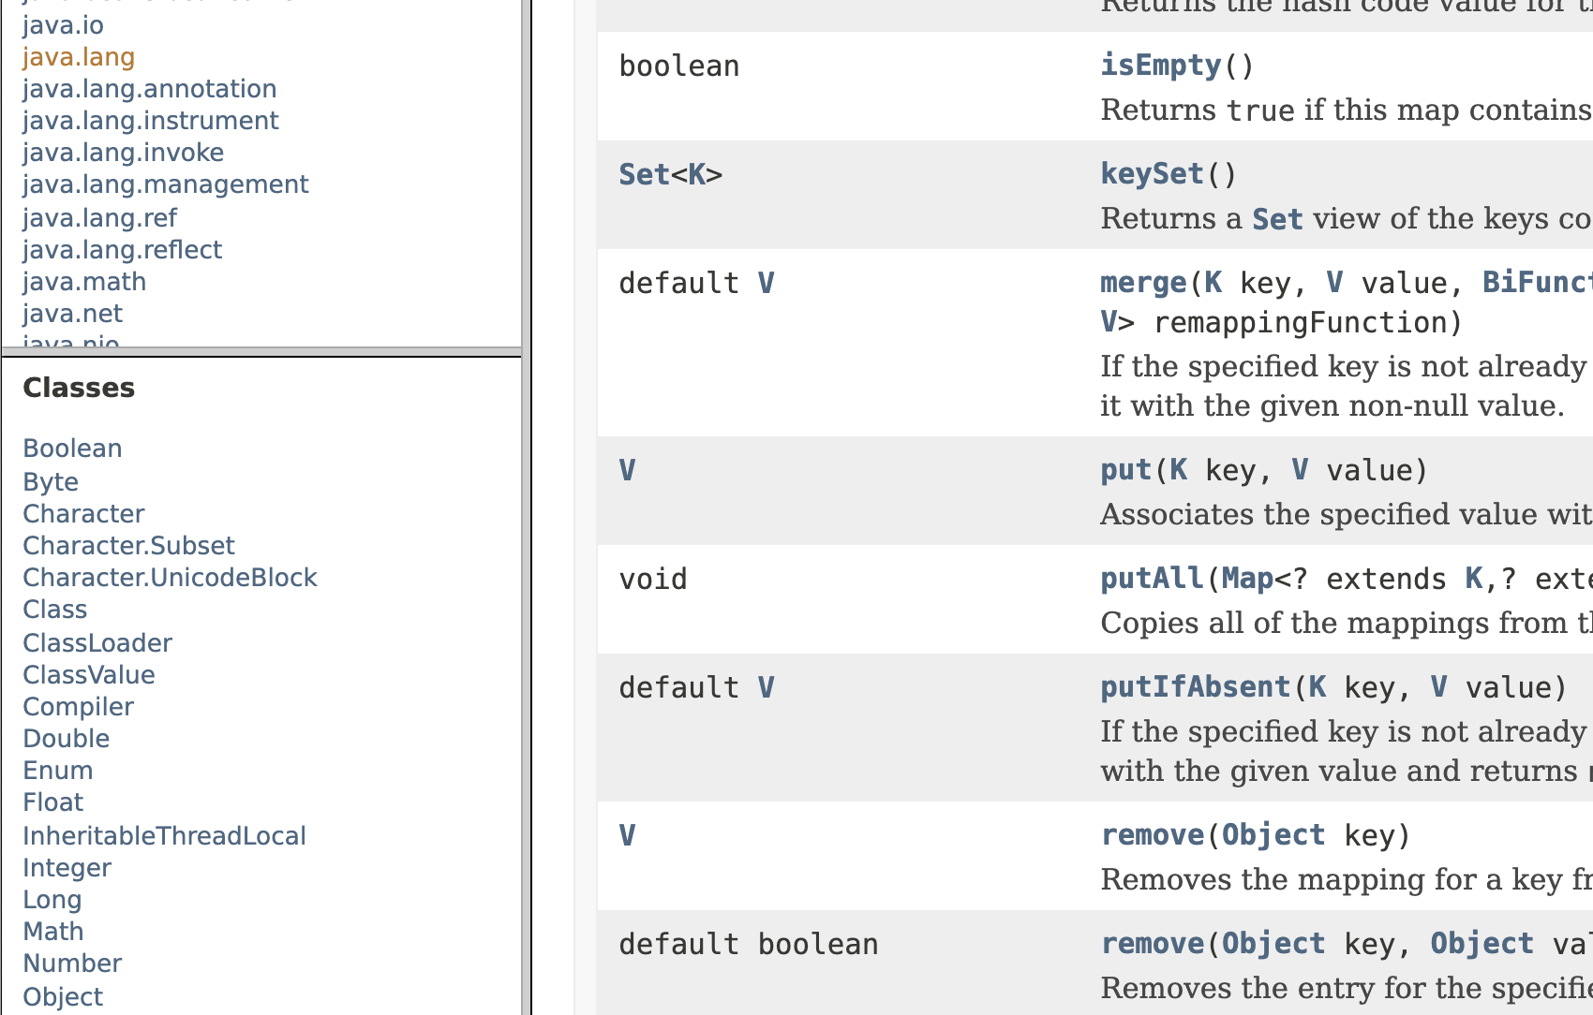

Slide 26
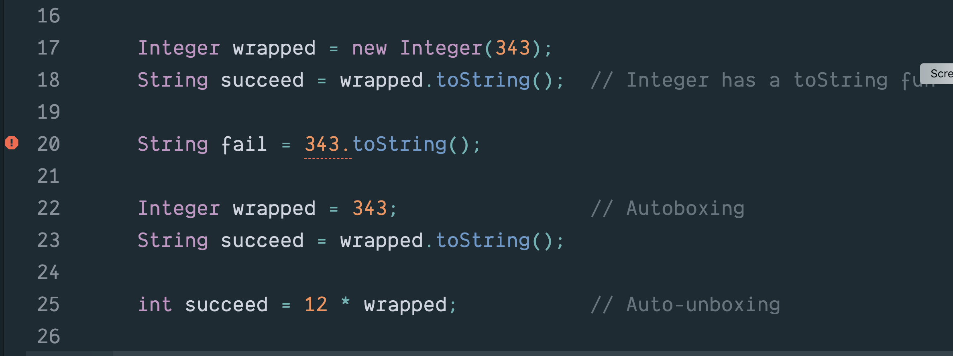
Base Types & Wrapper Classes

Slide 27
Digression 2: Exceptions
Each line of the input file has two strings and one integer;
The algs4 In class has readString and readInt functions;
What happens if there is no string or int to read?

Slide 28
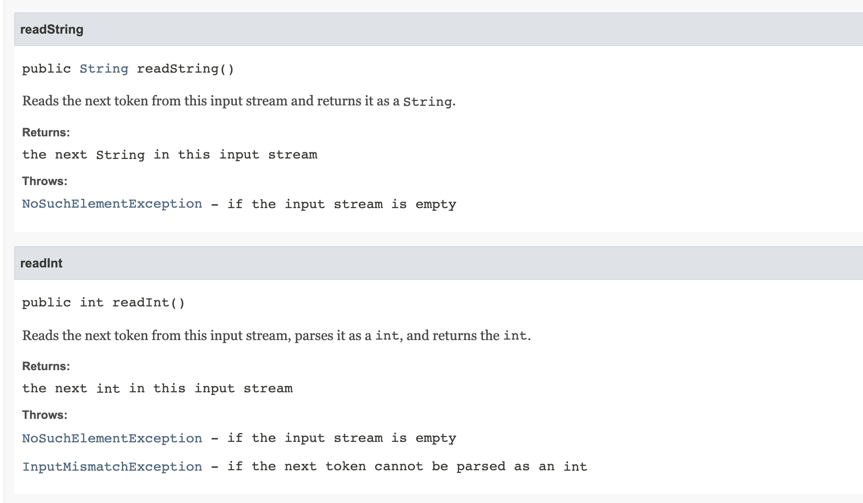
If an exception is thrown we need to catch it.
Values of base type int

Slide 29
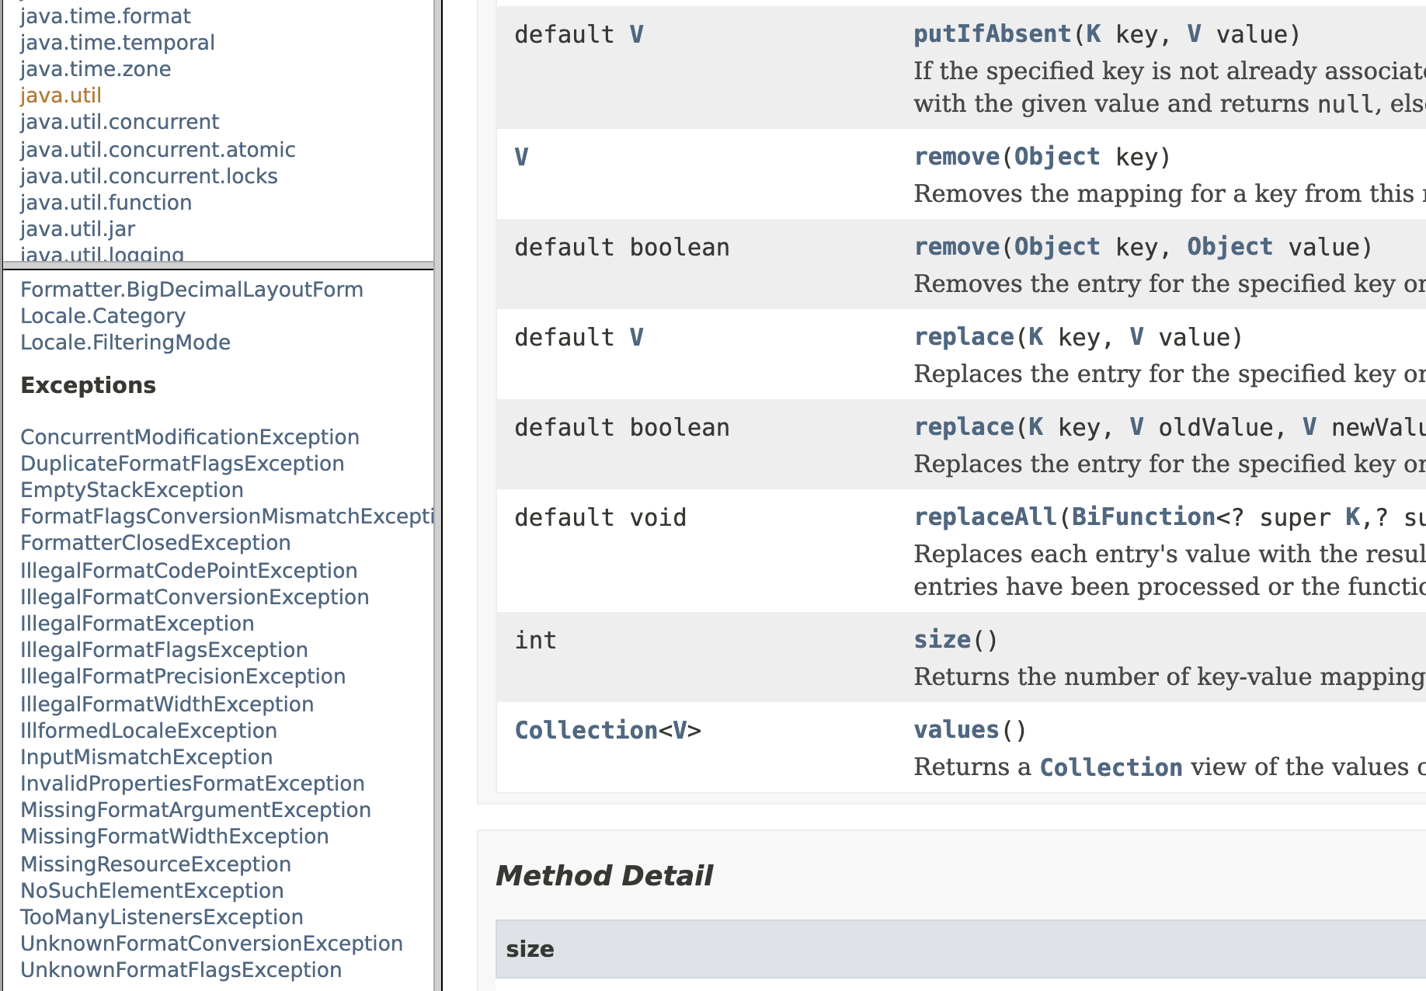

Slide 30
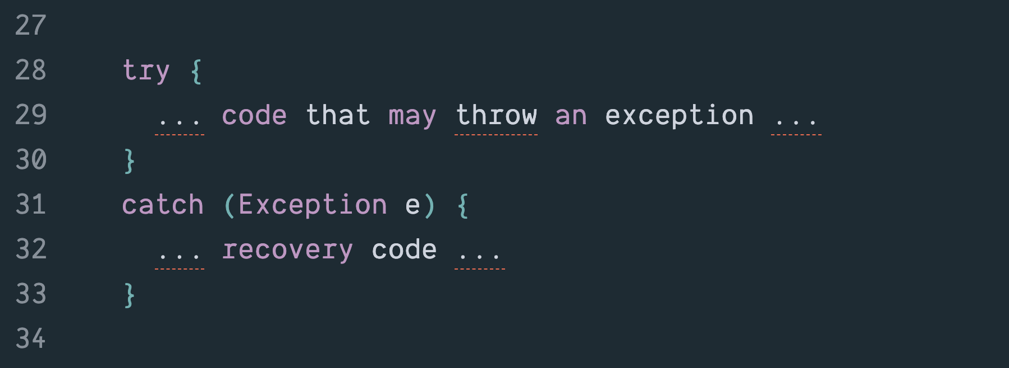
Handling Exceptions

Slide 31
Code

Slide 32
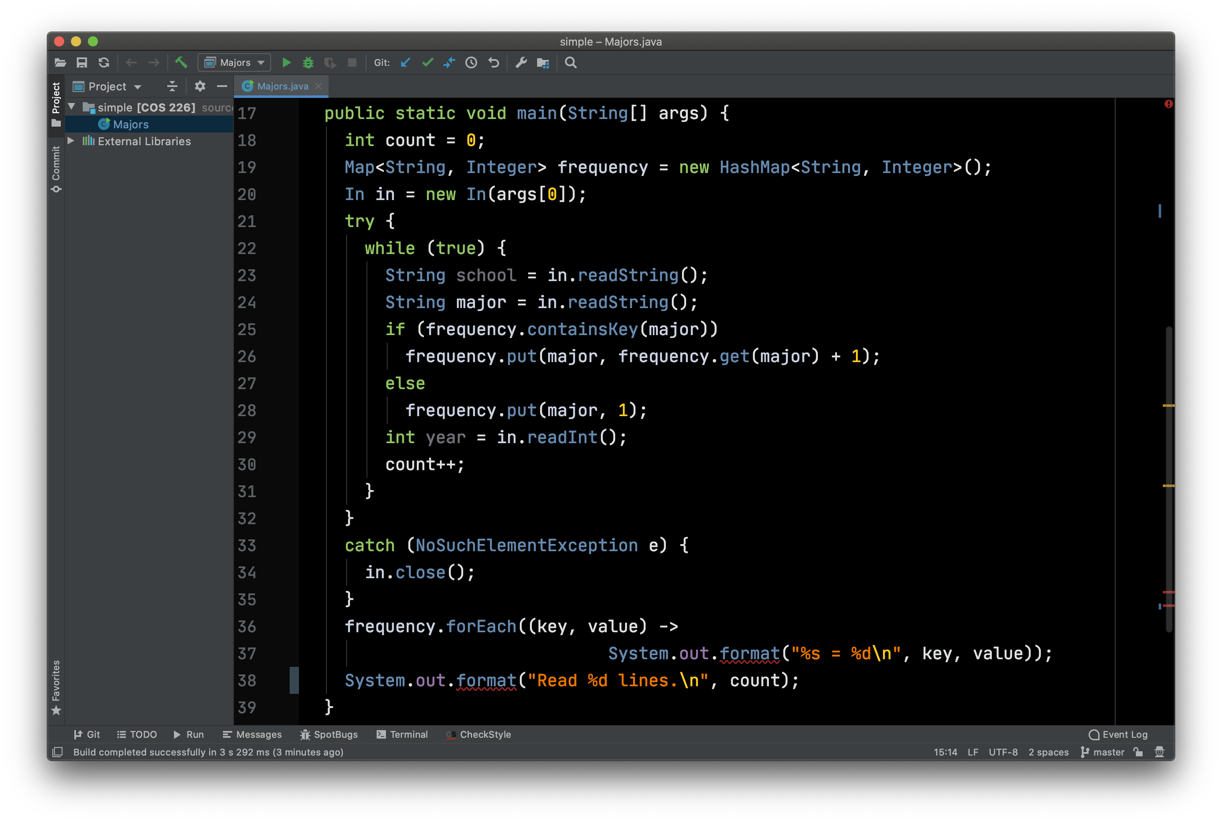
Compute a Frequency Table of Majors

